Slide 1
LAND
AND
AIR POLLUTION

Slide 2
AIR POLLUTION
PRESENCE OF CONTAMINANTS LIKE
DUST
SMOKE
MIST
ODOUR
IN ATMOSPHERE

Slide 3
AIR POLLUTANTS
CARBON MONOXIDE
NITROGEN DIOXIDE
SULPHUR DIOXIDE
SUSPENDED PARTICULATE MATTER
OZONE
SMOG
LEAD
HYDROCARBONS
CHROMIUM

Slide 4
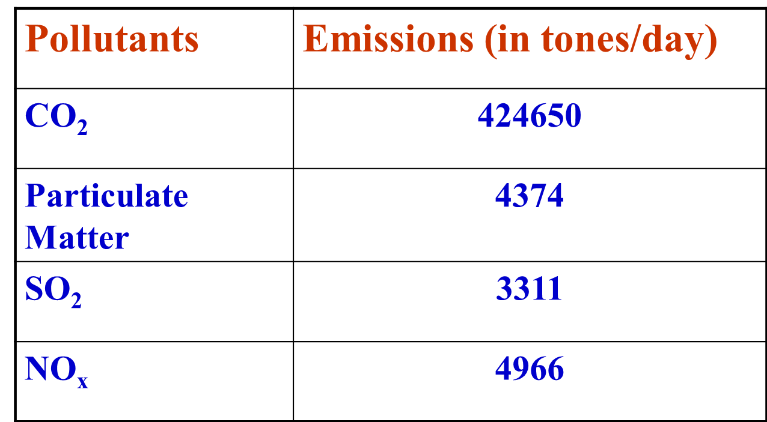
POLLUTION LOAD FROM COAL BASED THERMAL POWER PLANT

Slide 5
Health Effects of Air Pollution
The World Health Organization states that 2.4 million people die each year from causes directly attributable to air pollution, with 1.5 million of these deaths attributable to indoor air pollution
Various diseases caused by air pollution
Lung cancer
Mesothelioma Cancer of the mesothelial membrane lining the lungs
Asbestosis Slow, debilitating disease of the lungs
Cardiopulmonary disease linked to breathing fine particle air pollution.
Asthma

Slide 6
CARBON MONOXIDE
FORMED BY INCOMPLETE COMBUSTION OF CARBON
2C + O2 ----→ 2CO
BURNING OF FOSSIL FUELS
CIGARETTE SMOKE
MOTOR VEHICLE EXHAUST

Slide 7
EFFECTS OF CO
REACTS WITH HAEMOGLOBIN OF BLOOD AND REDUCES THE ABILITY OF BLOOD TO BRING O2
HEADACHE, ANEMIA
BRAIN CELL DAMAGE
INCREASE IN GLOBAL TEMPERATURE

Slide 8
NITROGEN DIOXIDE
REDDISH BROWN GAS
REACTS WITH MOISTURE TO GIVE NITRIC ACID
NO₂ + MOISTURE HNO₃
CAUSES
FOSSIL FUEL BURNING
INDUSTRIAL PLANT EMISSIONS

Slide 9
EFFECTS
LUNG IRRITATION
HNO3 DAMAGES TREES,SOILS,AQUATIC LIFE
CORRODES METALS
DAMAGES FABRICS

Slide 10
SULPHUR DIOXIDE
->COLOURLESS GAS
->FORMED BY COMBUSTION OF SULPHUR
->CONVERTED TO H2SO4 WITH AIR
CAUSES
->COAL COMBUSTION
->INDUSTRIAL EMMISION

Slide 11
EFFECTS
BREATHING PROBLEMS
ACID DEPOSITION OF H2SO4 DAMAGES
TREES, SOILS &AQUATIC LIFE IN LAKES

Slide 12
LEAD
SOURCES:
PAINT
MANUFACTURE OF LEAD
BATTERIES
LEADED PETROL

Slide 13
EFFECTS
ACCUMULATES IN BODY BRAIN AND
NERVOUS SYSTEM
RETARDS MENTAL GROWTH
CAUSES CANCER
DAMAGE TO WILDLIFE

Slide 14
ACID RAIN
Sulfur dioxide and nitrogen dioxide are transformed in the atmosphere to produce acid compounds – sulfuric and nitric acids. These compounds then fall back on to the ground as particulates or raindrops – in other words, acid rain.
So acid rain also falls on streams and lakes, acidifies them and destroys fish life in these freshwater ecosystems.
For example, in Sweden acid rain made over 18,000 lakes so acidic that all the fish died out. Salmon species appear to be particularly sensitive to acidity.

Slide 15
OZONE LAYER DEPLITION
Ozone depletion describes two distinct, but related observations: a slow, steady decline of about 4 percent per decade in the total volume of ozone in Earth's stratosphere (the ozone layer) since the late 1970s, and a much larger, but seasonal, decrease in stratospheric ozone over Earth's polar regions during the same period. The latter phenomenon is commonly referred to as the ozone hole

Slide 16
CAUSE
increased stratospheric concentration of chlorine from industrially produced CFCs , halons and selected solvents
Once in the stratosphere, every chlorine atom can destroy up to 100 000 ozone molecules

Slide 17
CONSEQUENCES
increase in UV-B radiation at ground level: a one percent loss of ozone leads to a two percent increase in UV radiation. Continuous exposure to UV radiation affects humans, animals and plants, and can lead to skin problems (ageing, cancer), depression of the immune system, and corneal cataracts (an eye disease that often leads to blindness). Increased UV radiation may also lead to a massive die-off of photoplancton (a CO ₂ "sink") and therefore to increased global warming.
disturbance of the thermal structure of the atmosphere, probably resulting in changes in atmospheric circulation;
reduction of the ozone greenhouse effect: ozone is considered to be a greenhouse gas. A depleted ozone layer may partially dampen the greenhouse effect. Therefore efforts to tackle ozone depletion may result in increased global warming.
changes in the tropospheric ozone and in the oxidising capacity of the troposphere.

Slide 18
How to reduce Air Pollution ?
You can help to reduce Air Pollution by driving good condition
vehicles, walking wherever possible, bicycling, and using mass
transit. Stop burning wastes, refusals and dry grass & leaves.
Plant trees and avoid purchasing products un-friendly to
environment. Support and follow Air Act / Laws. Let us help
each other in making cleaner and healthier atmosphere where we live.

Slide 19
REDUCTION EFFORTS
>There are various air pollution control technologies and land use planning strategies available to reduce air pollution. At its most basic level land use planning is likely to involve zoning and transport infrastructure planning.
>increased fuel efficiency (such as through the use of hybrid vehicles)
>conversion to cleaner fuels (such as bioethanol, biodiesel, or conversion to electric vehicles).
Control devices
>Mechanical collectors (dust cyclones, multicyclones)
>Electrostatic precipitators Baghouses Designed to handle heavy dust loads
Particulate scrubbers Wet scrubber is a form of pollution control technology
Low NOx burners

Slide 20
Prevention of air pollution
1.We should share vehicles for going to office.
2.We should get a regular pollution check of our vehicle.
3.We should use a bicycle for going to near by places.
4.Chimneys of factories should be fitted with proper filters to
prevent smokes from coming out and effect atmosphere.
5. Industrial wastes should be properly disposed

Slide 21
Land Pollution
Land pollution refers to the degradation of the land due to human activities, such as the exploitation of minerals, poor disposal of waste and improper utilization of soil. Land pollution is caused by domestic and nuclear wastes, industrial wastes, deforestation, human sewage, mining and other factories and increased mechanization.

Slide 22
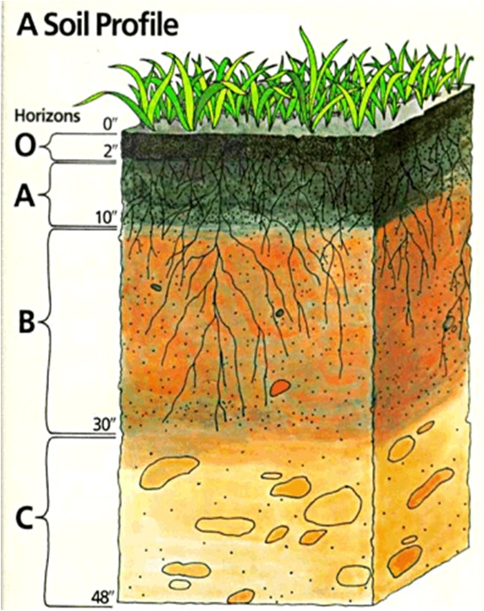
O Horizon – Organic matter
A Horizon – Top soil
B Horizon – Subsoil
C Horizon – Parent

Slide 23
Types of land pollution
Solid waste
Topsoil Erosion
Soil loss and desertification
Hazardous waste
>Reactive waste >Corrosive waste
>Ignitable waste >Toxic waste
>Radioactive waste >Medical waste
>Home waste

Slide 24
Sources
>Chemical and nuclear plants
>Industrial factories >Oil refineries
>Human sewage
>Oil and antifreeze leaking from cars
>Mining >Littering
>Overcrowded landfills >Deforestation 10.Construction debris

Slide 25
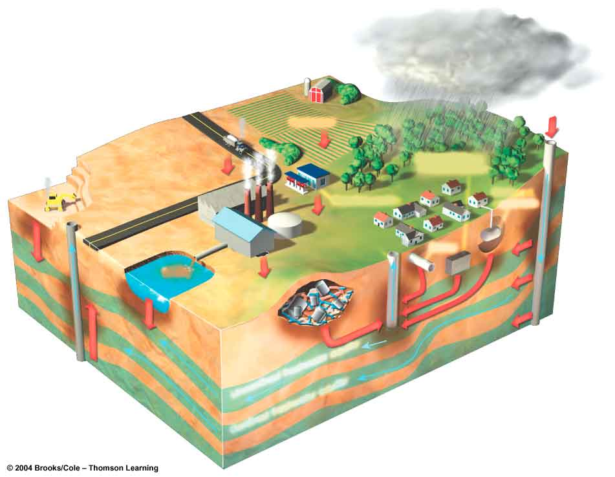
Sources: A diagrammatic view
Hazardous waste injection well
Pesticides
Coal strip mine runoff
Buried gasoline and solvent tank
Cesspool septic tank
Gasoline station
Waste lagoon
Water pumping well
Sewer
Landfill
Accidental spills
Leakage from faulty casing
Discharge
Unconfined freshwater aquifer
Confined aquifer
Confined freshwater aquifer
Groundwater flow

Slide 26
Major Causes
One major source of land pollution is the agricultural industry. Long-term use of pesticides, chemical fertilizers and herbicides threaten agricultural production.
Increase in urbanization leads to the exploitation and destruction of forests.
The disposal of non-biodegradable wastes, including containers, bottles and cans made of plastic, used cars and electronic goods, leads to the pollution of land.
The process of mining leads to the formation of piles of coal and slag which accumulate and contaminate the land.
Improper treatment of sewage leads to the accumulation of solids, such as biomass sludge.

Slide 27
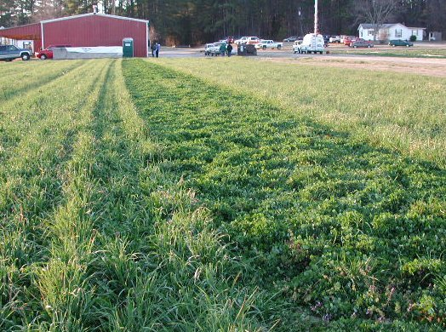
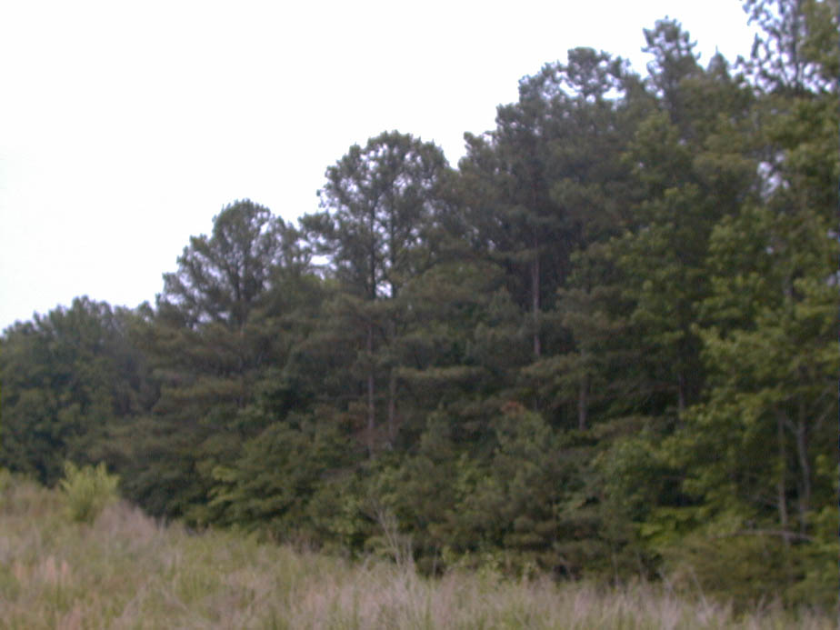
avoiding use of chemicals
Non-Biological methods of control of pests and diseases is a main cause of causing salinity of the soil .
The salinity of the soil degrades the quality of soil and decreases productivity resulting in lesser output.
This can be best rectified or controlled by the ‘time tillage’ to give crops the best advantage from the soil minerals and also reduces the degradation of soil .

Slide 28
LANDFILLS
Landfill: a site where wastes are disposed of by burial.
Sanitary landfill: A landfill where wastes are spread in layers and compacted by bulldozers.
Landfills are a popular way to dispose of the waste, but aren’t very practical.
Now, they are leaning towards sanitary landfills, but they can also be quite deceiving.

Slide 29
Curbing the land pollution
Incinerators
Recycle
Don’t waste eatable food
Do Not Litter

Slide 30
Recycling Is Important
We believe that it is the responsible thing to do to increase recycling.
This takes only a couple minutes out of your week to separate plastics from Styrofoam.
It is just like doing laundry and separating blacks and colors.
The residents of the country should also try and do their part and put in at least one day of litter picking up.

Slide 31
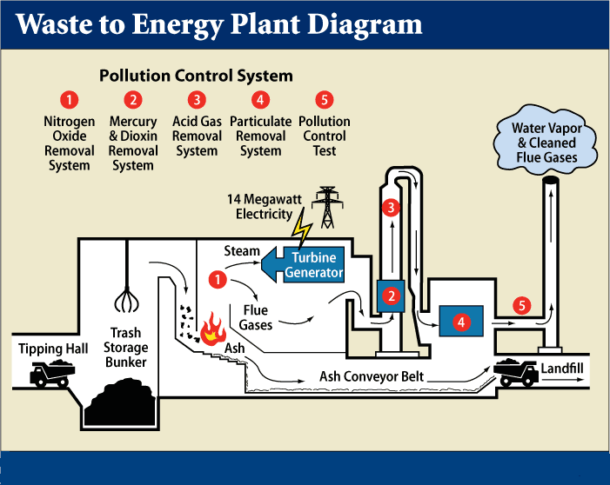
Garbage Incinerator

Slide 32
Making a better future
As a country we can also build more incinerators.
While these machines are highly expensive; they are completely worth it.
These would clean the world up in no time, even just having one in every state, or every major city would make they world a better place.

Slide 33
THANK YOU

